Slide 1
IT’s time to reassess the management of paediatric asthma
Prepared February 2025

Slide 2
1 IN 9
AUSTRALIANS REPORT
HAVING ASTHMA
Nearly 2.8 million people¹
IN 2022
386,000
CHILDREN (UNDER THE AGE OF 15) HAD ASTHMA
10.2% of boys (1 in 10)
6.2% of girls (1 in 6)¹
Notes:
1. Australian Bureau of Statistics (2023). National Health Survey 2022: Asthma. www.abs.gov.au/statistics/health/health-conditions-and-risks/asthma/latest-release#management

Slide 3
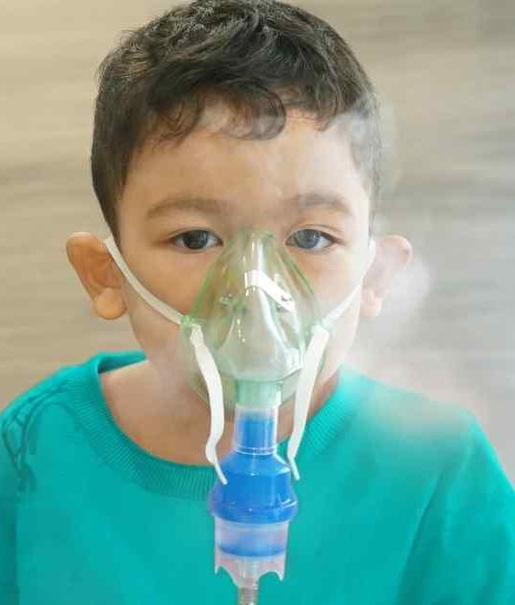
ASTHMA WAS THE
LEADING CAUSE
of disease burden in 2024 for children
1st for 1–4-year-olds
1st for 5–9-year-olds
2nd for 10–14 year-olds²
Notes:
2. Australian Institute of Health and Welfare. (2024). Australian Burden of Disease Study 2024. Retrieved from www.aihw.gov.au/reports/burden-of-disease/australian-burden-of-disease-study-2024

Slide 4
EMERGENCY DEPARTMENT (ED)
26,500
ABOUT
children under 15 visited an ED for asthma in 2021/2022³
HOSPITALS
13,500
43%
children under 15 were hospitalised for asthma in 2022/2023⁴
of all asthma hospitalisations were in children under 15 in 2022/2023⁴
Notes:
3. Australian Institute of Health and Welfare. (2024). Asthma. Retrieved from www.aihw.gov.au/reports/chronic-respiratory-conditions/asthma
4. Australian Institute of Health and Welfare. (2024) Principal diagnosis data cubes. Separation statistics by principle diagnosis, 2022-23. https://www.aihw.gov.au/reports/hospitals/principal-diagnosis-data-cubes

Slide 5
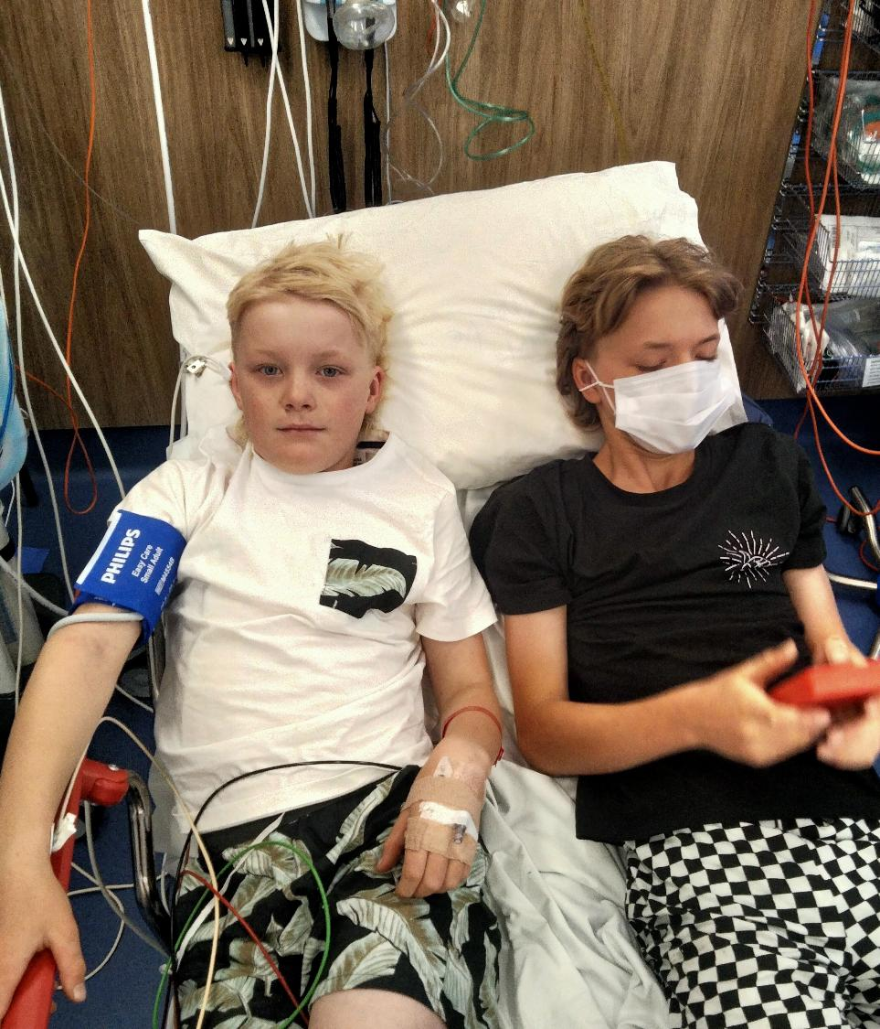
READMISSION
1 IN 3
children are readmitted to hospital for asthma within 12 months
compared to 1 in 5 a decade ago⁵
Notes:
5. Chen, K. Y., Chu, W., Jones, R., Vuillermin, P., Fuller, D., Tran, D., Sanci, L., Shanthikumar, S., Carlin, J., & Hiscock, H. (2023). Modifiable factors associated with pediatric asthma readmissions: a multi-center linked cohort study. The Journal of asthma : official journal of the Association for the Care of Asthma, 60(4), 708–717. https://doi.org/10.1080/02770903.2022.2089996

Slide 6
PRIMARY CARE UTILISATION
9 GP VISITS
in 12 months prior to admission of children 3-18 in 2017-2018
5 distinct GPs across 4 different practices⁶
Notes:
6. Chen, K. Y., Jones, R., Lei, S., Shanthikumar, S., Sanci, L., Carlin, J., & Hiscock, H. (2023). Primary health care utilization and hospital readmission in children with asthma: a multi-site linked data cohort study. Journal of Asthma, 60(8), 1584–1591. https://doi.org/10.1080/02770903.2022.2164200

Slide 7
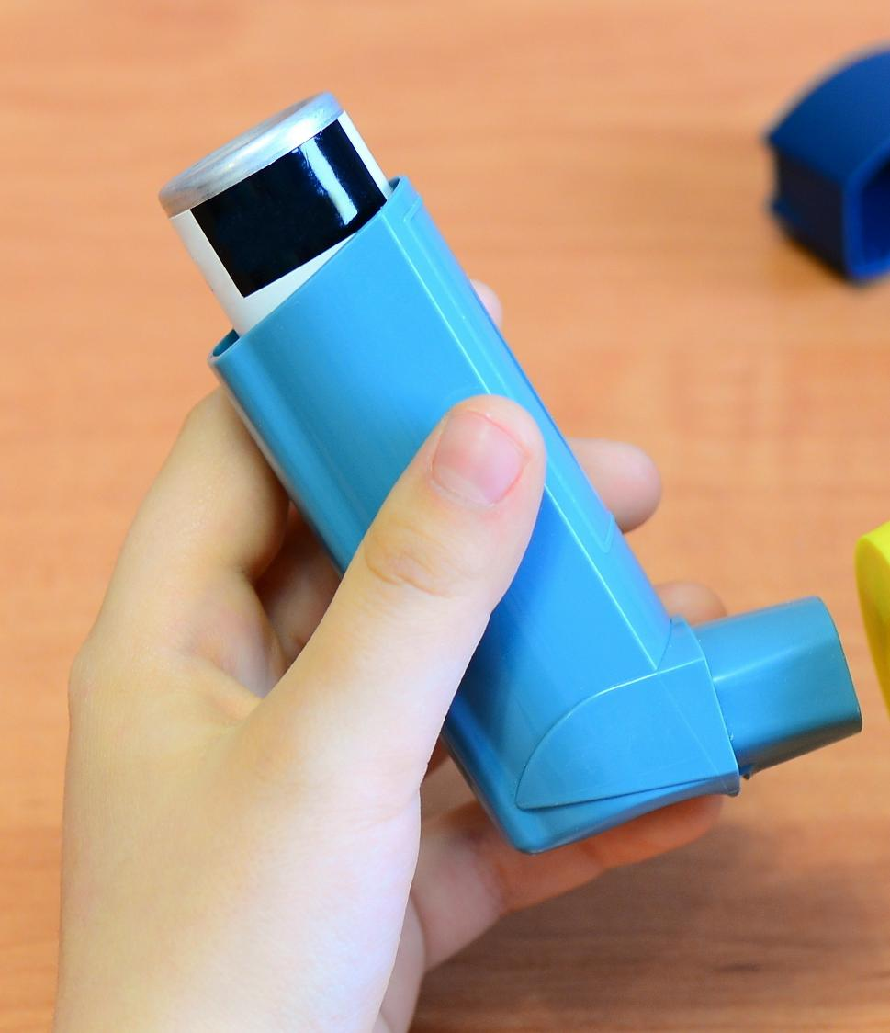
RELIEVER OVERUSE
1 IN 4
children rely heavily on reliever medicine
25% of children aged 0-14 who were dispensed at least one reliever inhaler (SABA or AIR) were dispensed three or more in a 12-month period in 2022-2023³
Notes:
3. Australian Institute of Health and Welfare. (2024). Asthma. Retrieved from www.aihw.gov.au/reports/chronic-respiratory-conditions/asthma

Slide 8
ICS UNDERUSE
ONE THIRD
LESS THAN
of children aged 0-14 collected the three or more preventer medicines expected within 12 months in 2022-23 to indicate good adherence prescriptions³
Notes:
3. Australian Institute of Health and Welfare. (2024). Asthma. Retrieved from www.aihw.gov.au/reports/chronic-respiratory-conditions/asthma

Slide 9
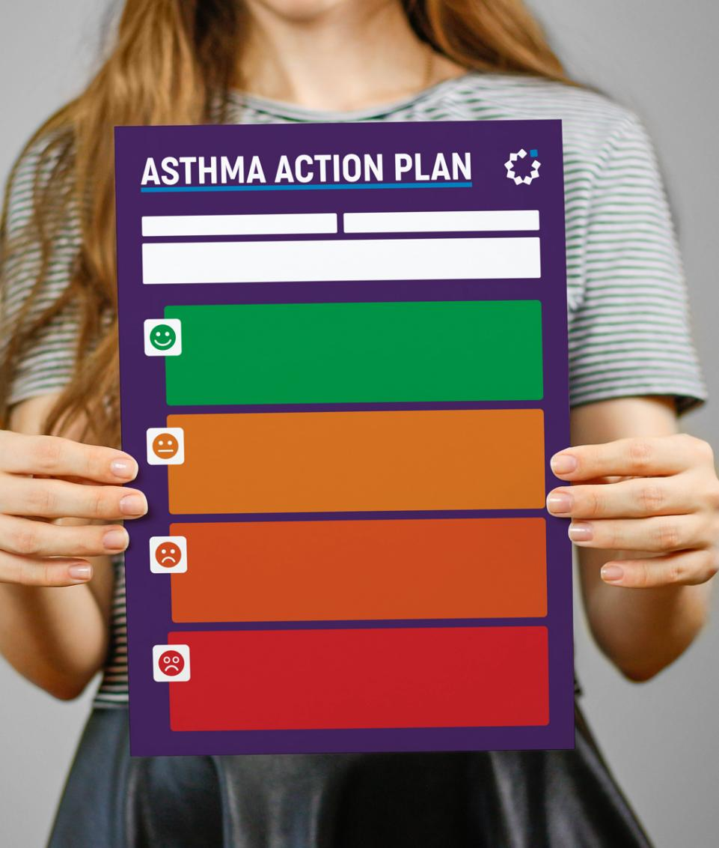
ASTHMA ACTION PLAN
2 IN 3
ONLY
children (67%) had an Asthma Action Plan in 2022¹
Notes:
1. Australian Bureau of Statistics (2023). National Health Survey 2022: Asthma. www.abs.gov.au/statistics/health/health-conditions-and-risks/asthma/latest-release#management

Slide 10
Coordinated care approaches showing success
Combining…
Asthma self-management education
Environmental assessments
Strong primary-tertiary care connections
Person-centred approach with shared decision-making
…can significantly improve outcomes^{7,8}
Notes:
7. Homaira N, et al. Impact of integrated care coordination on pediatric asthma hospital presentations. Front Pediatr. 2022 10, 929819.
8. Shanthikumar S, et al. The current state of pediatric asthma in Australia. Pediatr Pulmonol. 2024 59(6), 1829–1831.

Slide 11
REFERENCES
1. Australian Bureau of Statistics (2023). National Health Survey 2022: Asthma. www.abs.gov.au/statistics/health/health-conditions-and-risks/asthma/latest-release#management 2. Australian Institute of Health and Welfare. (2024). Australian Burden of Disease Study 2024. Retrieved from www.aihw.gov.au/reports/burden-of-disease/australian-burden-of-disease-study-2024 3. Australian Institute of Health and Welfare. (2024). Asthma. Retrieved from www.aihw.gov.au/reports/chronic-respiratory-conditions/asthma 4. Australian Institute of Health and Welfare. (2024) Principal diagnosis data cubes. Separation statistics by principle diagnosis, 2022-23. https://www.aihw.gov.au/reports/hospitals/principal-diagnosis-data-cubes. 5. Chen KY, et al. Modifiable factors associated with pediatric asthma readmissions: a multi-center linked cohort study. J Asthma. 2023 60(4), 708–717. 6. Chen KY, et al. Primary health care utilization and hospital readmission in children with asthma: a multi-site linked data cohort study. J Asthma. 2023 60(8), 1584–1591. 7. Homaira N, et al. Impact of integrated care coordination on pediatric asthma hospital presentations. Front Pediatr. 2022 10, 929819. 8. Shanthikumar S, et al. The current state of pediatric asthma in Australia. Pediatr Pulmonol. 2024 59(6), 1829–1831.
^{Prepared February 2025.}

