Slide 1


Asthma Art Attack
Resource Kit

Slide 2
ACTIVITY :
Model of an Asthma Puffer or Spacer

Slide 3
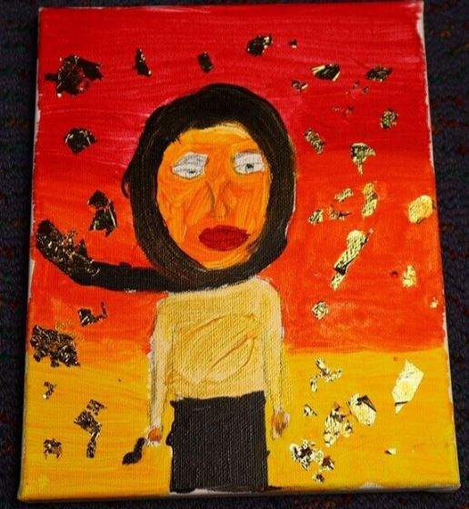

1.1 Student’s experience with asthma
Grade 5 student
What helps you with your asthma?
This is a self portrait of me holding my asthma puffer.

Slide 4
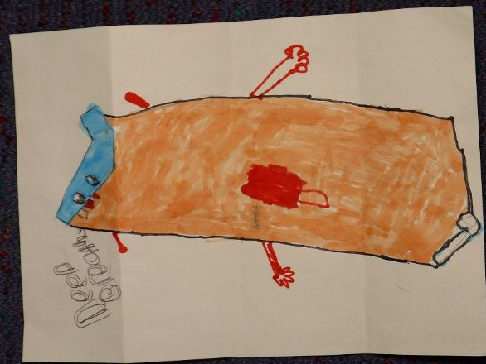
1.2 Student’s experience with asthma
Grade 3 student
What helps you with your asthma?
I drew a puffer human as I use my puffer when I need it. The puffer makes me feel calm.

Slide 5
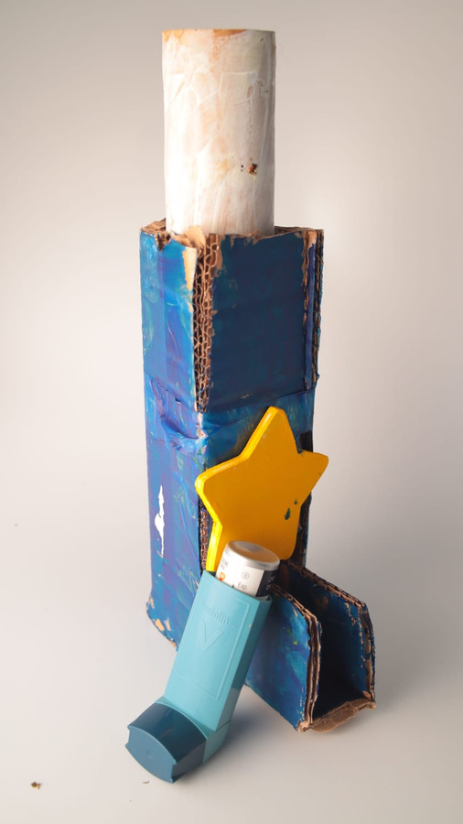
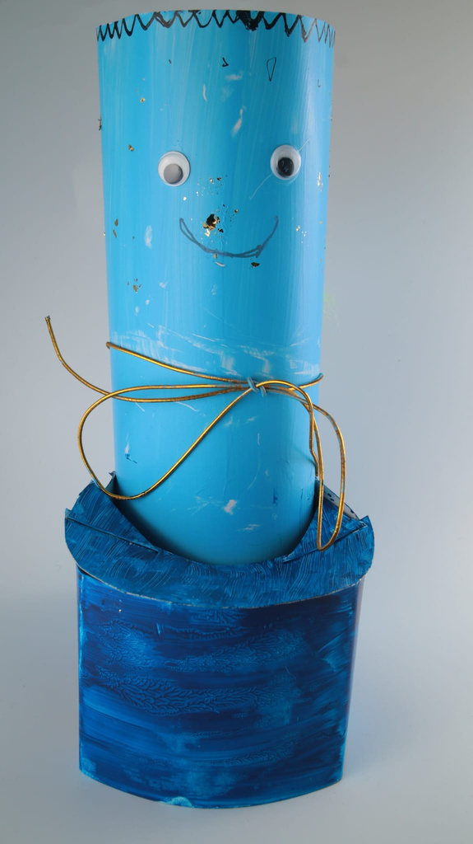
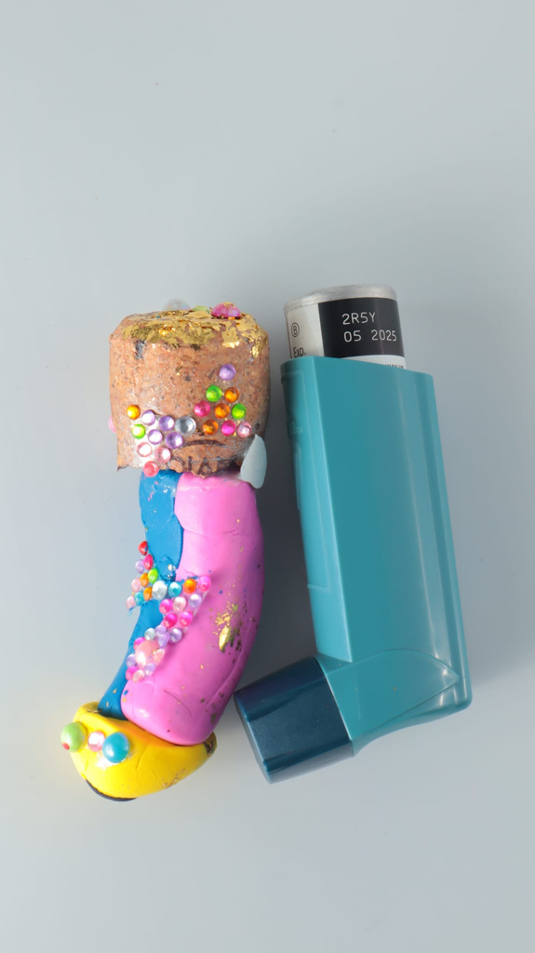
1.3 Examples of Student Artworks- Asthma Puffer

Slide 6
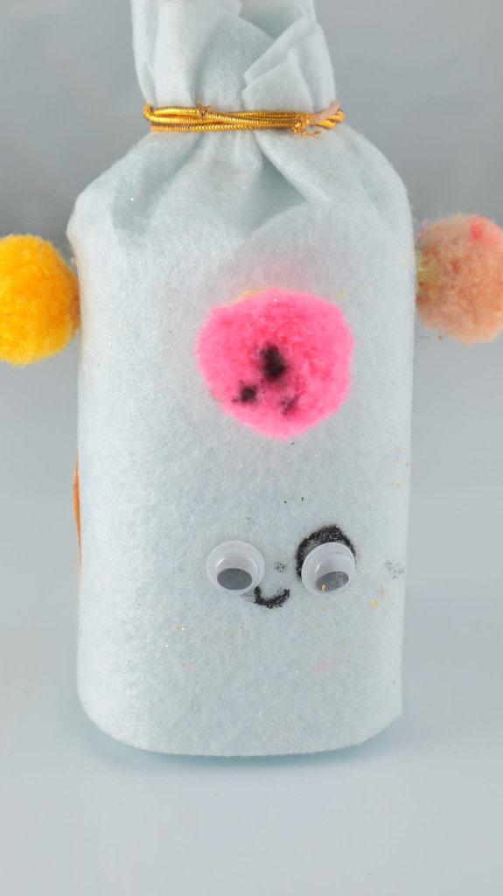
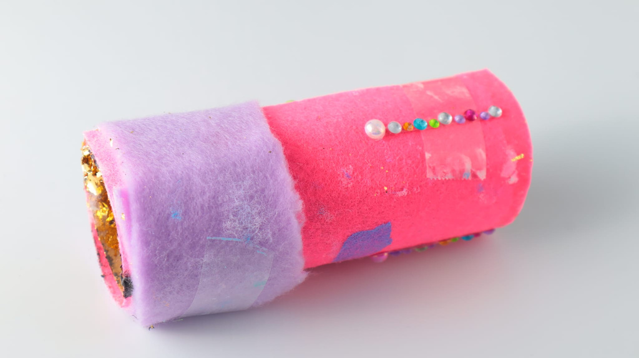
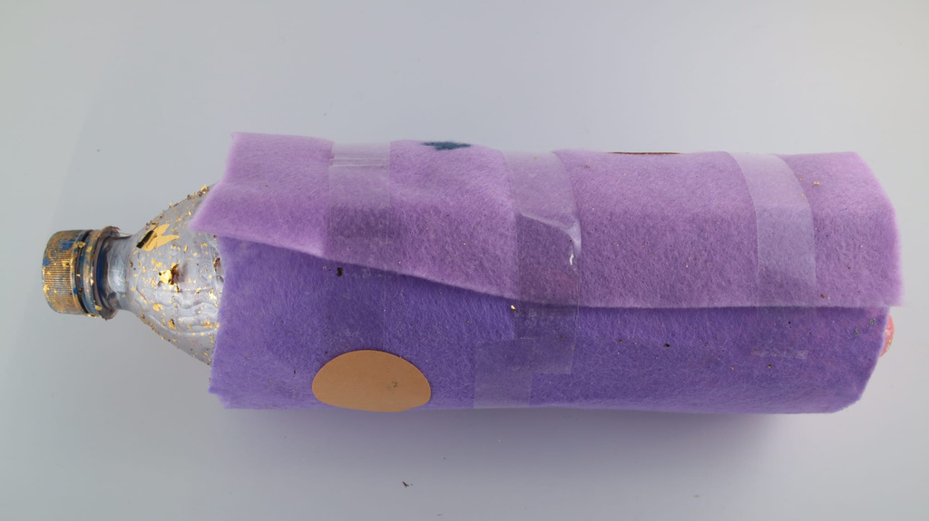
1.4 Examples of Student Artworks- Asthma Spacer

