Slide 1


Asthma Art Attack
Activity resource kit

Slide 2
ACTIVITY:
Asthma Support Poster

Slide 3
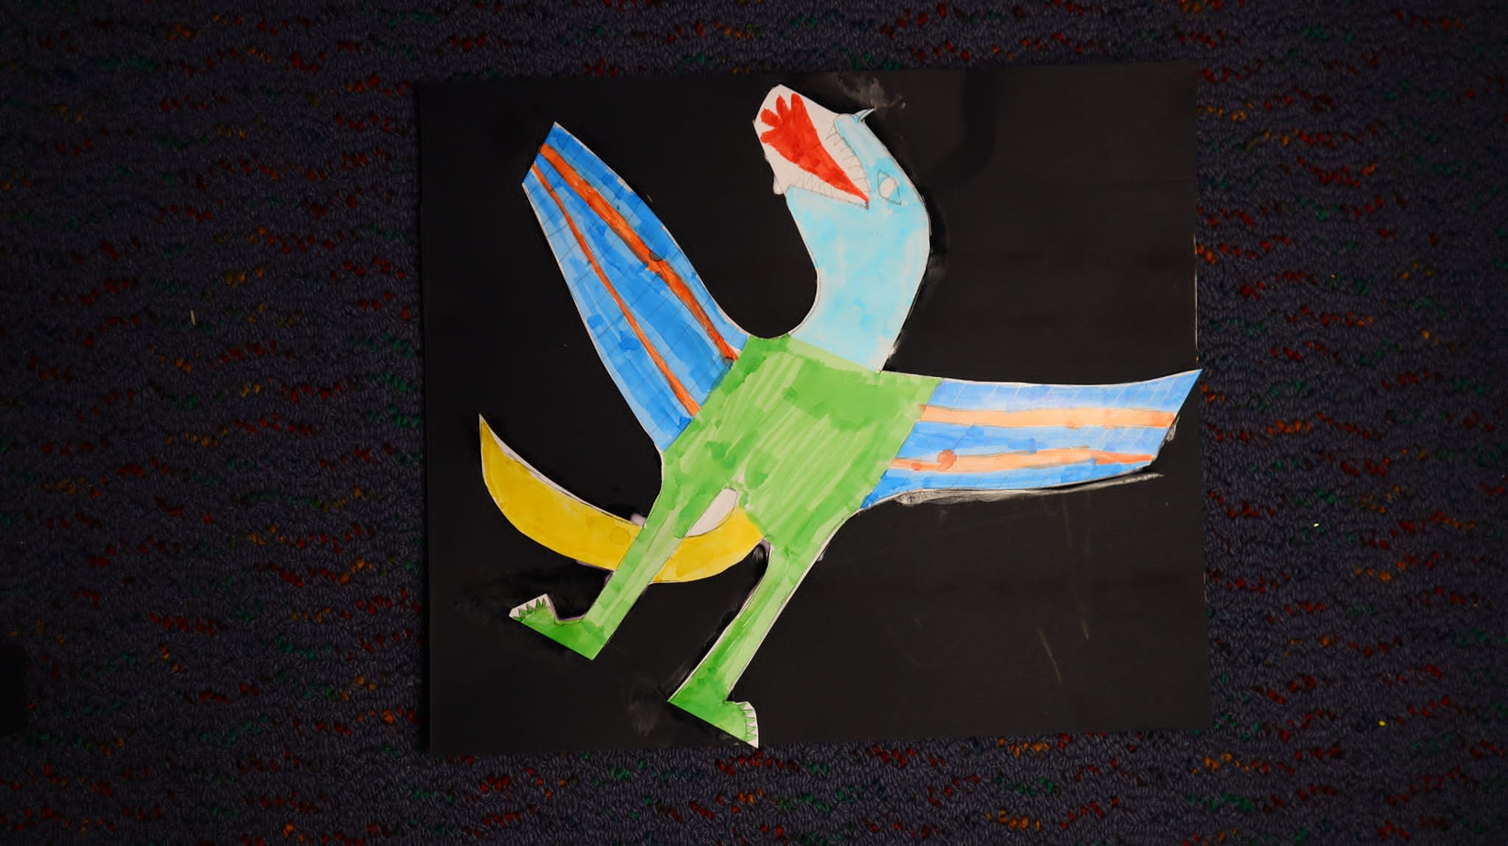

2.1 Student’s experience with asthma
Grade 6 student
What don’t you like about having asthma
‘I drew a picture of a dragon with short breath. A dragon usually has a strong fiery breath. It shows what it feels like to have short breath, like when I run.’

Slide 4
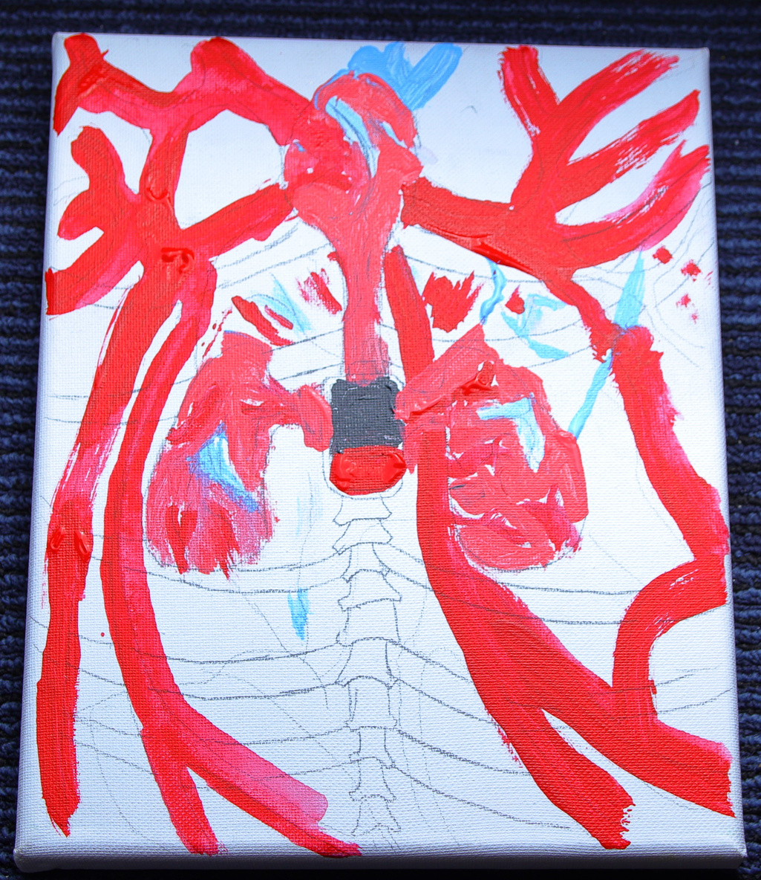
2.2 Student’s experience with asthma
Grade 6 student
What don’t you like about having asthma
‘I did a drawing and painting on canvas showing the inside of the body. The middle grey square represents low battery and that is how I feel when I have asthma.’

Slide 5
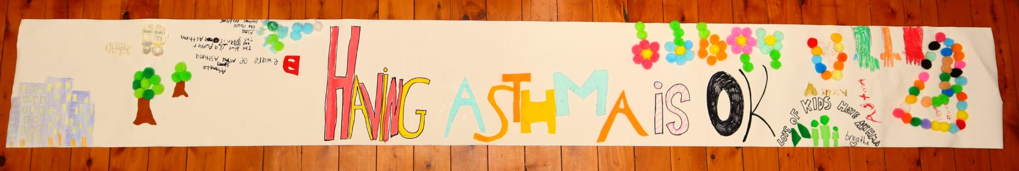
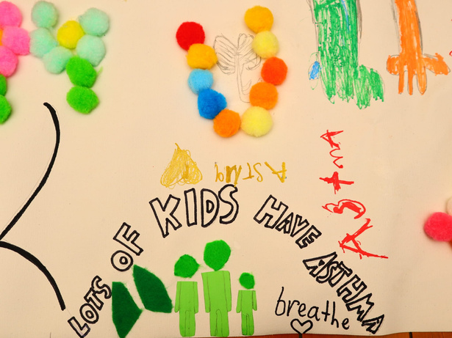
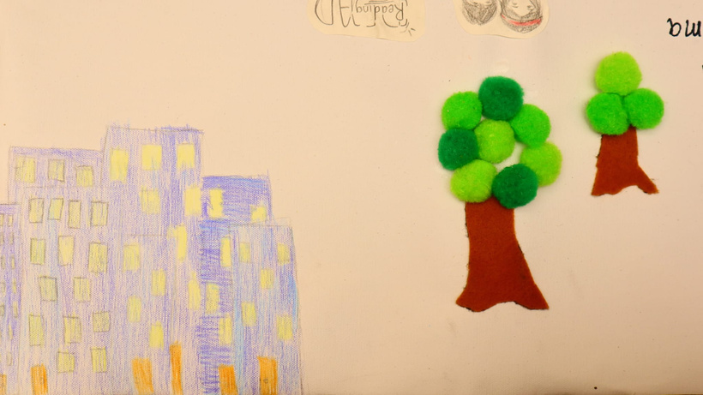

2.3 Examples of Student Artworks- Asthma Support Banner

