Slide 1


Asthma Art Attack
Activity resource kit

Slide 2
ACTIVITY:
Mixed Media Artwork

Slide 3
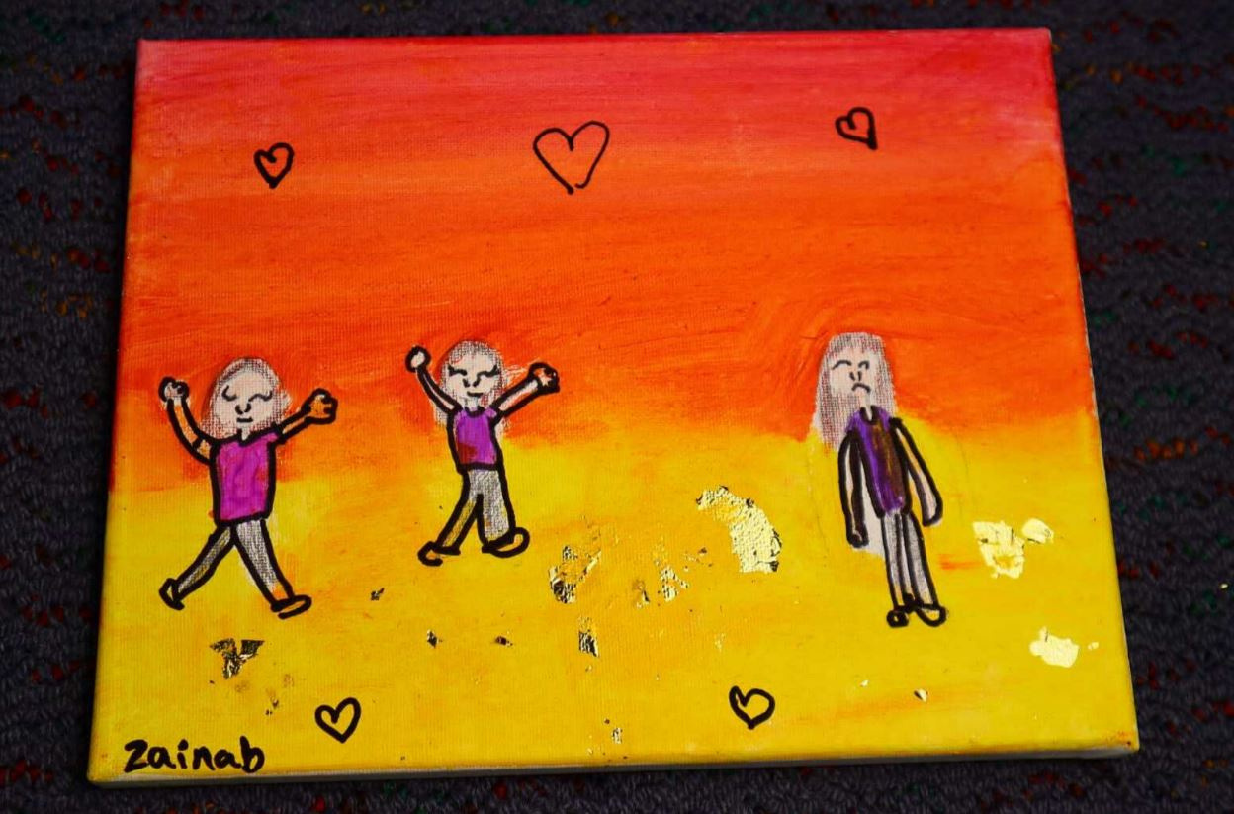

3.1 Student’s Experience with Asthma
Grade 6 Student
What don’t you like about having asthma?
‘I painted two girls playing and one girl with asthma is not playing. It represents people not being able to play as much because of their asthma.’

Slide 4
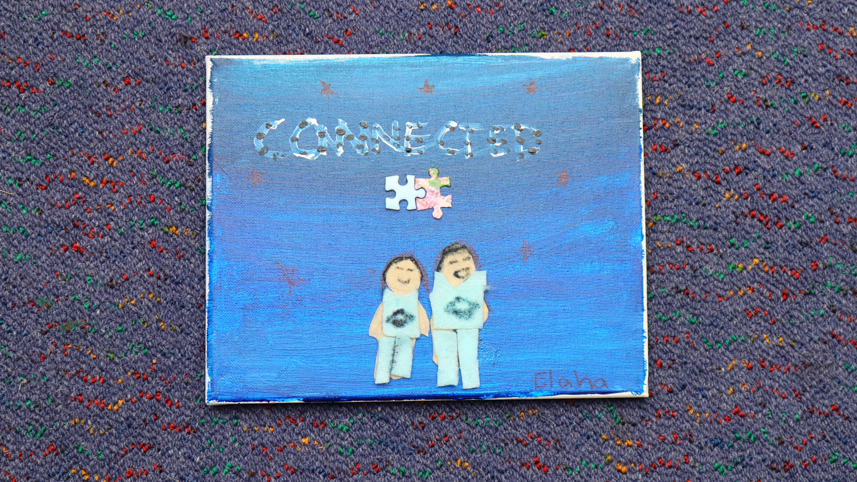
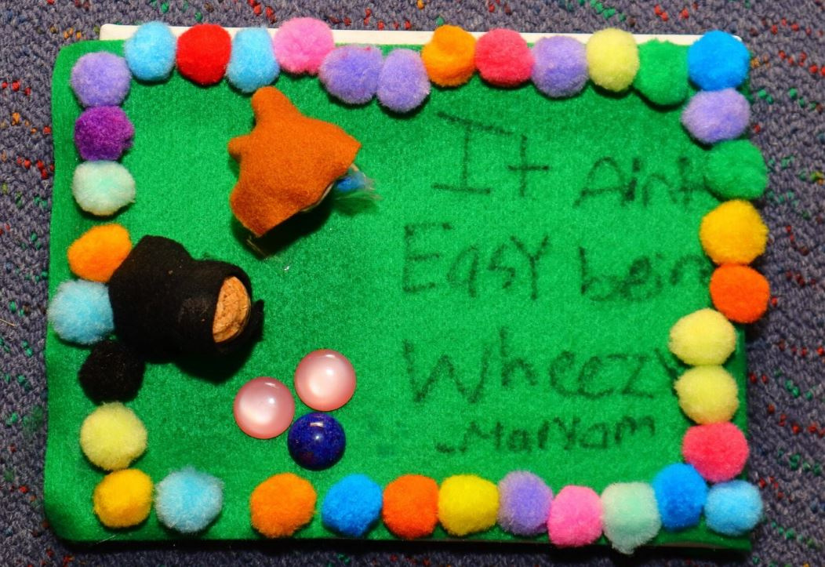
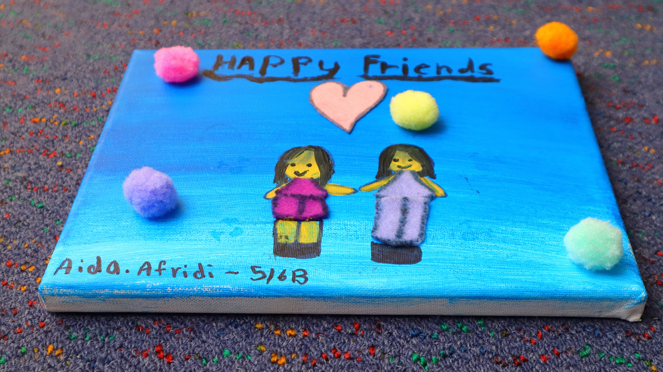
3.2 Examples of Student Artworks- Asthma Mixed Media artwork

